Slide 1



Slide 2
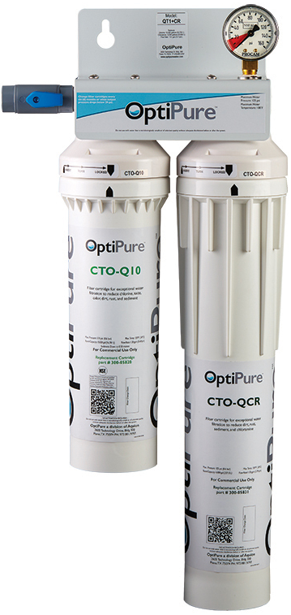
Model: QT1+CR
Part# 160-52080
Replacement Cartridges:
CTO-Q10 Part# 300-05828
CTO-QCR Part# 300-05831
OptiPure QT1+CR is recommended for all boilerless ES and GS (spritzer)
Convotherm Combi Ovens where
water quality is -
Within Published Standards
Mini thru 10.20 models:
Replace cartridges annually
12.20, 20.10 and 20.20 models:
Replace cartridges every 6 months
Chlorine reduction
Chloramine reduction
½ micron particle filtration

Slide 3
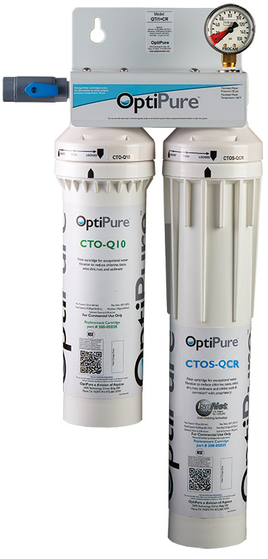

Model: QTI1+CR
Part# 160-52081
Replacement Cartridges:
CTO-Q10 Part# 300-05828
CTOS-QCR Part# 300-05832
OptiPure QTI1+CR is recommended for all Cleveland Steamers and EB and GB (generator) Convotherm Combi Ovens where water quality is -
Within Published Standards
All Cleveland Steamer models:
See guide for replacement frequency
Mini thru 10.10 models:
Replace cartridges annually
10.20 thru 20.20 models:
Replace cartridges every 6 months
Chlorine reduction
Chloramine reduction
½ micron particle filtration
IsoNet® scale & corrosion inhibitor
IsoNet® ensures consistent dosing and protection by trapping and holding scale & corrosion inhibitor media within the water flow path of the OptiPure cartridge.

Slide 4
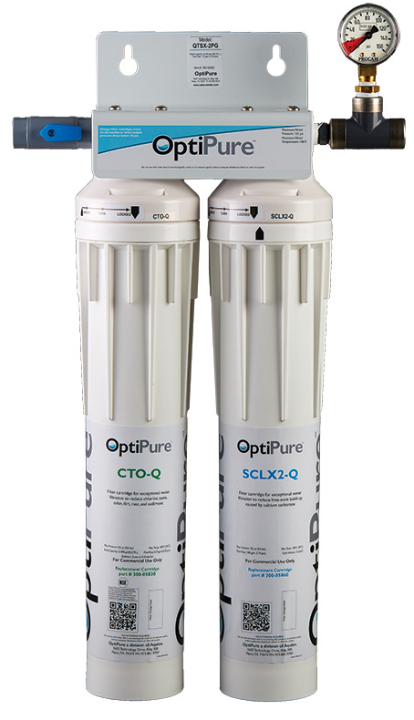

Model: QTSX2-PG
Part# 160-52822
Replacement Cartridges:
CTO-Q Part# 300-05830
SCLX-Q Part# 300-05860
OptiPure QTSX2-PGis recommended for all Cleveland Steamers and EB and GB (generator) Convotherm Combi Ovens where water quality is -
Chloride is Within Standard but water hardness is above standard and RO is not an option.
NOTE: pH should be 8.5 or lower
All Cleveland Steamer models:
See guide for replacement frequency
Mini thru 10.10 models:
Replace cartridges annually
10.20 thru 20.20 models:
Replace cartridges every 6 months
Chlorine reduction
½ micron particle filtration
ScaleX2® scale inhibitor
ScaleX2 instantly transforms dissolved calcium carbonate ions into microscopic particles that become suspended in solution greatly reducing the potential for scale formation.

Slide 5


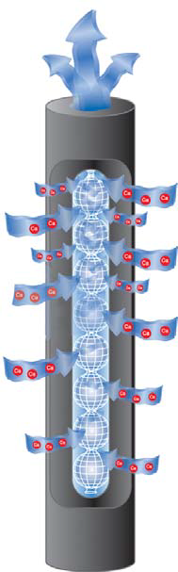
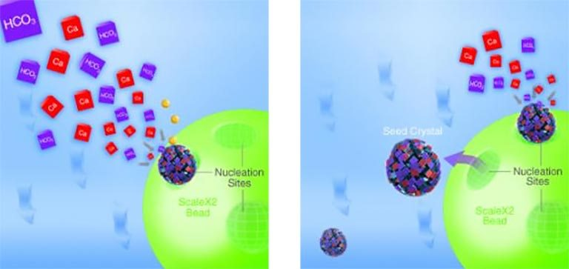
OptiPure Scale Inhibition
ScaleX2 instantly transforms dissolved calcium carbonate ions into microscopic particles that become suspended in solution greatly reducing the potential for scale formation.
IsoNet ensures consistent dosing by trapping and holding scale & corrosion inhibitor media within the water flow path of the OptiPure cartridge.

Slide 6
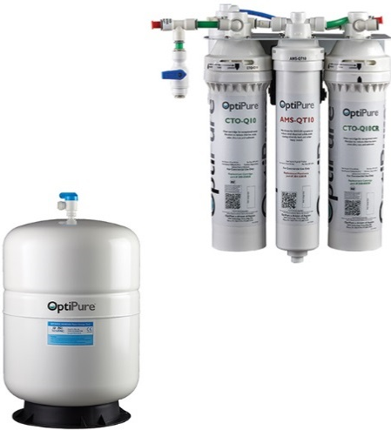
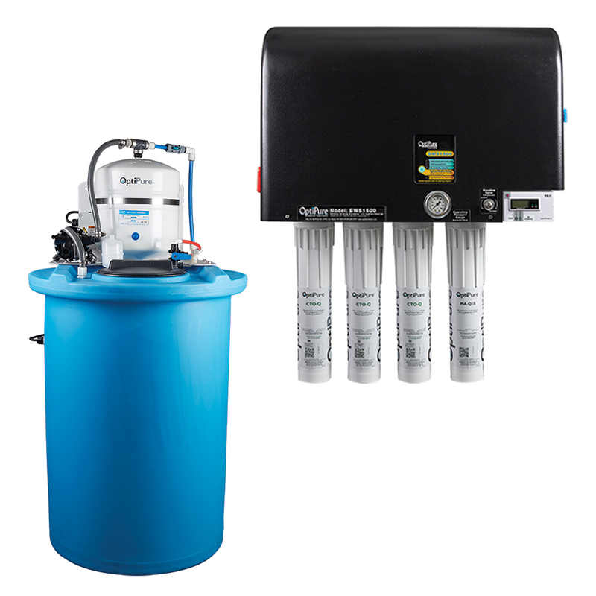
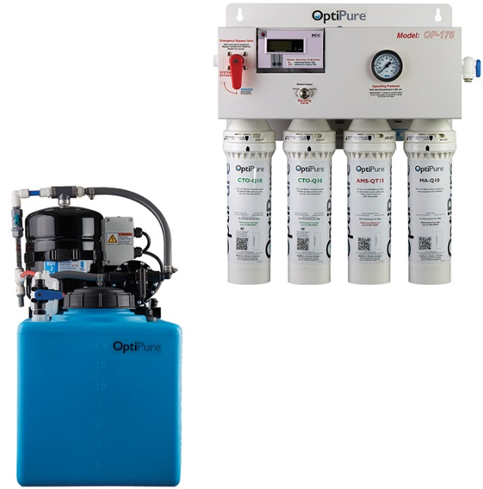
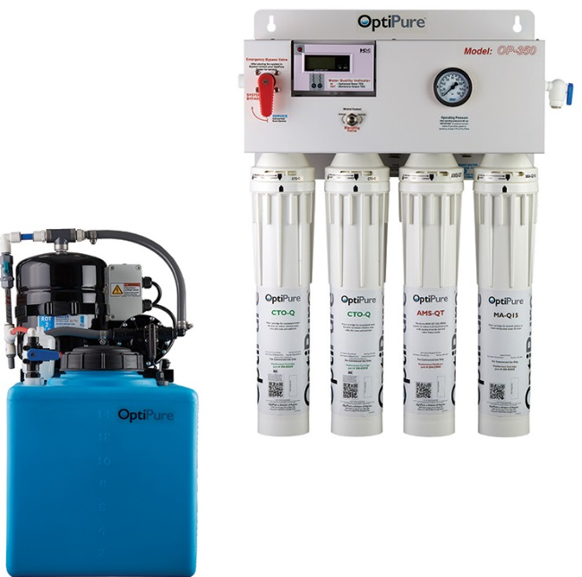
Reverse Osmosis Systems with Mineral Addition
RO + Mineral Addition = Optimized Water
OP70CR/5
BWS1500/50
OP175/16
OP350/16

Slide 7

OP70/5 Reverse Osmosis System
System includes:
High capacity pre-filter
RO membrane
Mineral addition
Chloramine reduction
5 gallon (net capacity) storage tank
Integrated manual bypass valve
Installation tubing and fittings
Ideal for the following Convotherm spritzer and generator models
where water quality is -
NOT Within Convotherm Standards
Convotherm models:
All Mini
6.10 boiler & spritzer
OP70CR/5 SYSTEM
Model Item# Description
OP70CR/5 160-01105 75 GPD RO/mineral addition with 5 gal tank
REPLACEMENT FILTERS & MEMBRANE
Cartridge Item# Qty Description Change Frequency
CTO-Q10 300-05828 1 Pre-filter Up to 6 months - based on pressure
ILMA6.14 252-70260 1 MA-filter Up to 6 months - based on pressure
AMS-QT10 204-52810 1 RO membrane 18 to 36 months based on production/rejection
CTO-Q10CR 300-05821 1 CR-filter Every 6 months
OPTIONAL EQUIPMENT
Component Item# Description
Air Gap Kit 164-89905 Air-gap for RO drain line
Pressure regulator 164-89938 Manages feed water supply pressure
*BPS100 164-85010 Booster pump assembly
*May be required when feed water supply pressure is below 50 psi

Slide 8
OP175/16 Reverse Osmosis System
System includes:
High capacity pre-filters
RO membrane
Mineral addition
Water Quality Monitor
Chloramine reduction (option)
15 gallon (net capacity) storage tank
Consistent flow and pressure from tank
Integrated manual bypass valve
Installation tubing and fittings
Ideal for the following Cleveland Steamer and Convotherm spritzer and generator models
where water quality is -
NOT Within Convotherm Standards
Cleveland Steamer models:
See application guide for recommended systems
Convotherm models:
See application guide for recommended systems
OP175/16 SYSTEM
Model Item# Description
OP175/16 164-00216 175 GPD RO/mineral addition with 16 gal tank & RP
REPLACEMENT FILTERS & MEMBRANE
Cartridge Item# Qty Description Change Frequency
CTO-Q10 300-05828 2 Pre-filter Up to 6 months - based on pressure
MA-Q10 300-05850 1 Post-filter Up to 6 months - change with Pre-filters
AMS-QT15 204-52820 1 RO membrane 18 to 36 months based on production/rejection
OPTIONAL EQUIPMENT
Component Item# Description
FXPT-11CR 160-50011 Chloramine post-treatment assy.
Air Gap Kit 164-89905 Air-gap for RO drain line
Pressure regulator 164-89938 Manages feed water supply pressure
*BPA200 164-85015 Feed Water Booster Pump
*Recommended when feed water supply pressure is below 50 psi

Slide 9
OP350/16 Reverse Osmosis System
System includes:
High capacity pre-filters
RO membrane
Mineral addition
Water Quality Monitor
Chloramine reduction (option)
16 gallon (net capacity) storage tank
Consistent flow and pressure from tank
Integrated manual bypass valve
Installation tubing and fittings
Ideal for the following Cleveland Steamer and Convotherm spritzer and generator models
where water quality is -
Not Within Convotherm Standards
Cleveland Steamer models:
See application guide for recommended systems
Convotherm models:
See application guide for recommended systems
OP350/16 SYSTEM
Model Item# Description
OP350/16 164-14416 350 GPD RO/mineral addition with 16 gal tank & RP
REPLACEMENT FILTERS & MEMBRANE
Cartridge Item# Qty Description Change Frequency
CTO-Q 300-05830 2 Pre-filter Up to 6 months - based on pressure
MA-Q15 300-05855 1 Post-filter Up to 6 months - change with Pre-filters.
AMS-QT 204-53040 1 RO membrane 18 to 36 months based on production/rejection
OPTIONAL EQUIPMENT
Component Item# Description
FXPT-11CR 160-50011 Chloramine post-treatment assy.
Air Gap Kit 164-89905 Air-gap for RO drain line
Pressure regulator 164-89938 Manages feed water supply pressure
*BPS-QT 164-85020 Feed Water Booster Pump
* May be required when feed water supply pressure is below 50 psi

Slide 10
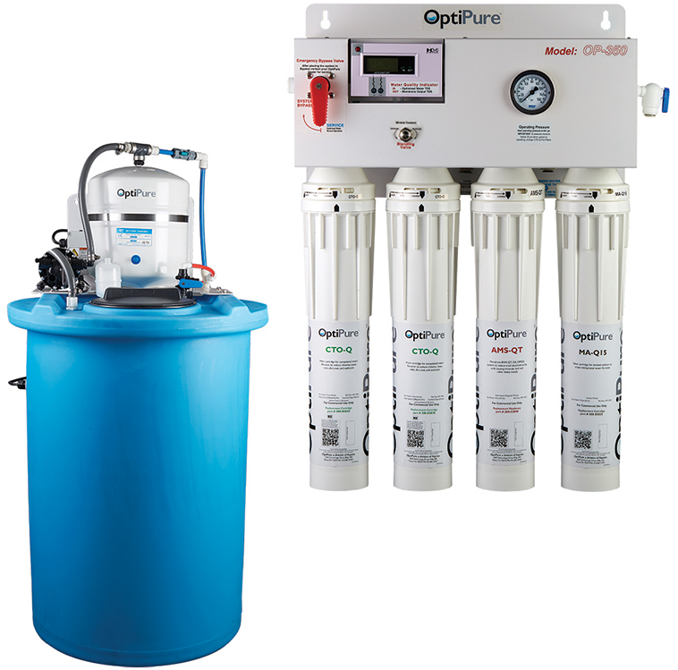
OP350/50 Reverse Osmosis System
System includes:
High capacity pre-filters
RO membrane
Mineral addition
Water Quality Monitor
Chloramine reduction (option)
50 gallon (net capacity) storage tank
Consistent flow and pressure from tank
Integrated manual bypass valve
Installation tubing and fittings
Ideal for High Volume / High Demand Cleveland Steamer applications
where water quality is -
Not Within Convotherm Standards
Cleveland Steamer models:
See application guide for recommended systems
Convotherm Models:
Stacks and multiple ovens
OP350/50 SYSTEM
Model Item# Description
OP350/50 164-14450 350 GPD RO/mineral addition with 50 gal tank & RP
REPLACEMENT FILTERS & MEMBRANE
Cartridge Item# Qty Description Change Frequency
CTO-Q 300-05830 2 Pre-filter Up to 6 months - based on pressure
MA-Q15 300-05855 1 Post-filter Up to 6 months - change with Pre-filters.
AMS-QT 204-53040 1 RO membrane 18 to 36 months based on production/rejection
OPTIONAL EQUIPMENT
Component Item# Description
FXPT-11CR 160-50011 Chloramine post-treatment assy.
Air Gap Kit 164-89905 Air-gap for RO drain line
Pressure regulator 164-89938 Manages feed water supply pressure
*BPS-QT 164-85020 Feed Water Booster Pump
* May be required when feed water supply pressure is below 50 psi

Slide 11
BWS1500/50 Reverse Osmosis System
System includes:
Microprocessor Controller
High capacity pre-filters
RO membrane
Mineral addition
Precision Blend Valve
Water Quality Monitor
Chloramine reduction (option)
50 gallon (net capacity) storage tank
Consistent flow and pressure from tank
Integrated manual bypass valve
Installation tubing and fittings
Many more features . . . .
Ideal for High Volume / High Demand - multiple Cleveland Steamer and Convotherm applications
where water quality is -
Not Within Convotherm Standards
Cleveland Steamer models:
See application guide for recommended systems

Slide 12
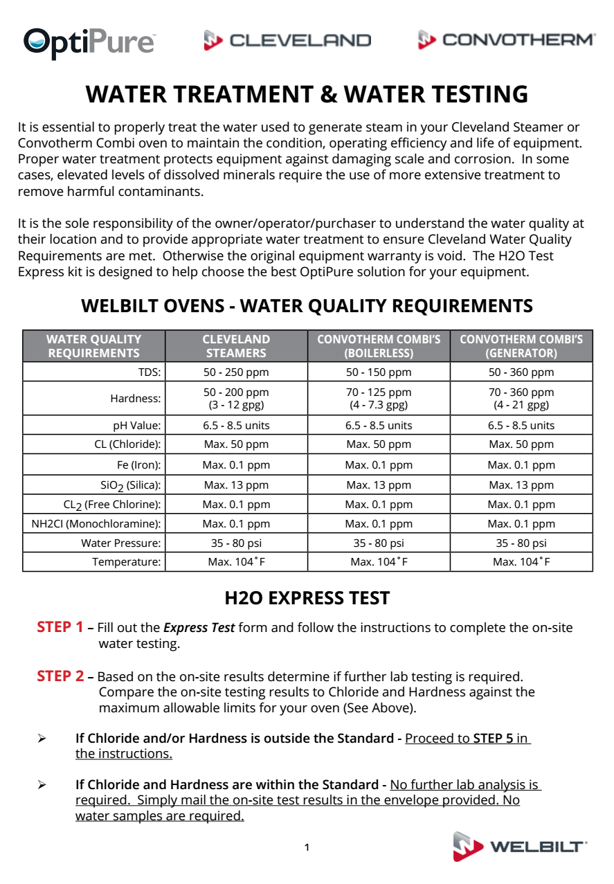
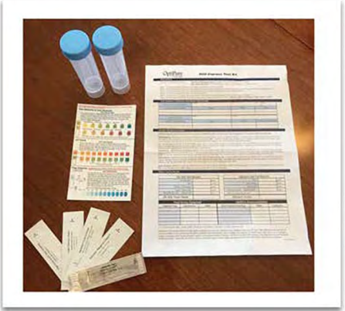

Slide 13
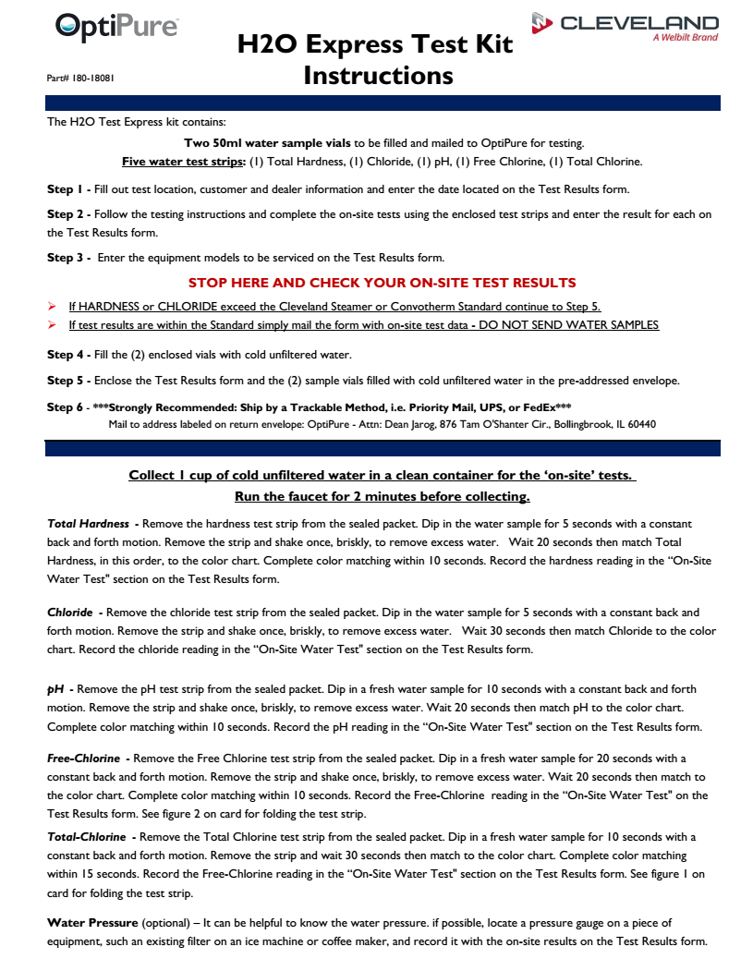
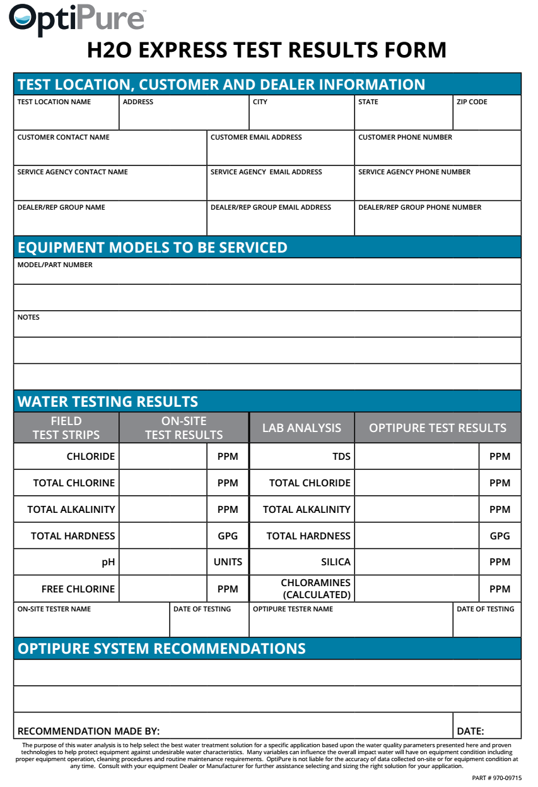

Slide 14
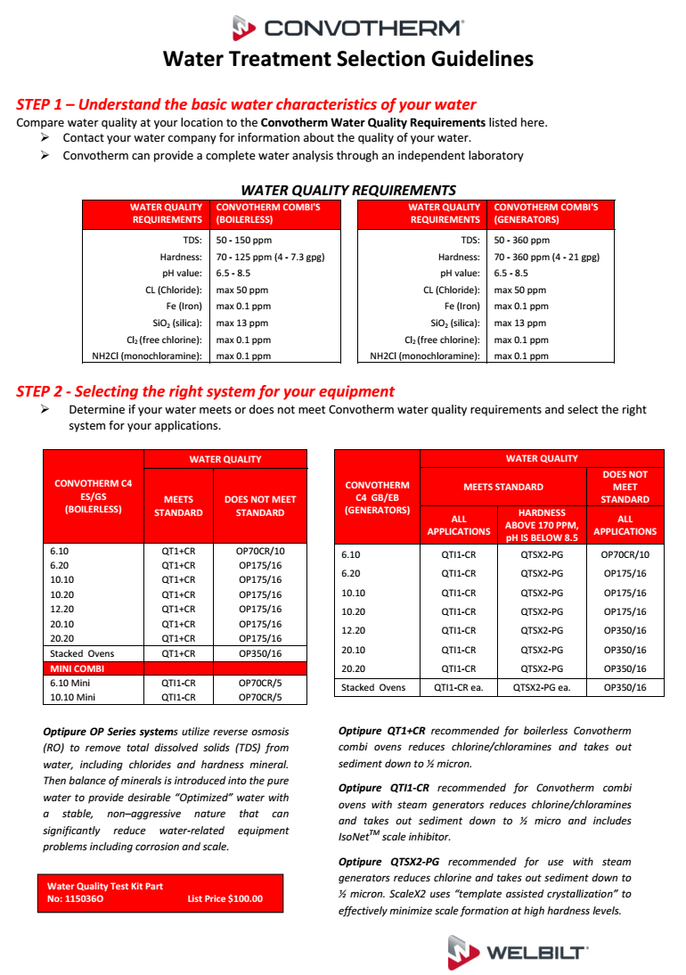
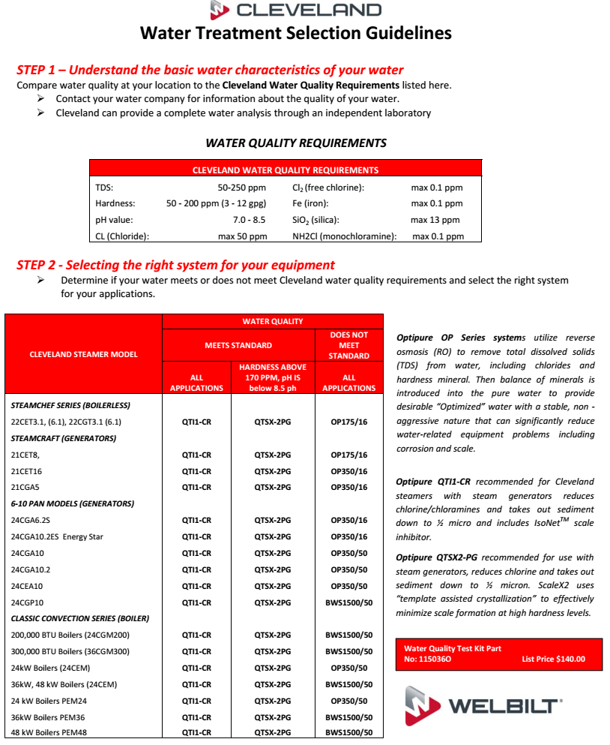

Slide 15
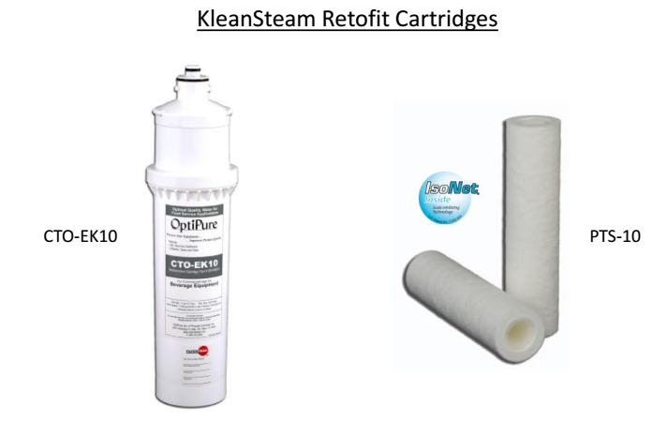
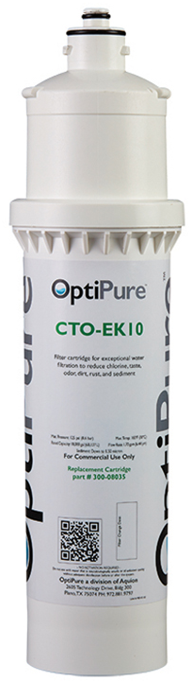
KleenSteam Retrofit Cartridges
Chlorine reduction -18,000 gal
½ micron particle filtration
Inhibit scale with IsoNet
Replaces 7CB5
Replaces Scalestick

